Slide 1
Pipe Traversing Robot
Screw-drive In-pipe robot

Slide 2
Pipe Traversing Bot
The gas pipeline is subjected to periodic inspection and maintenance.
Our project aims to automate this work with the help of the pipe traversing bot which can travel through these pipes, inspect and send the results periodically. They can even travel to the pipe where it is difficult for a humans to reach. They can be even trained to repair the defect which in turn saves money, time, and labor.

Slide 3
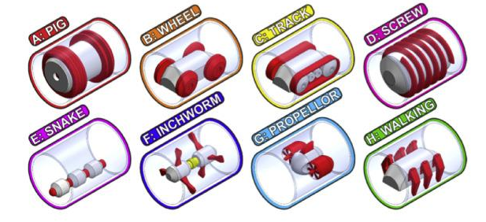
Popular Mechanisms
This is some of the common mechanisms which are used in the industry each of these mechanisms have their advantages and their disadvantages.

Slide 4
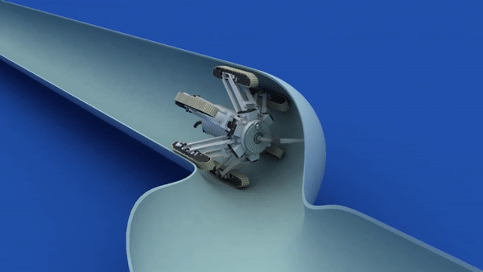
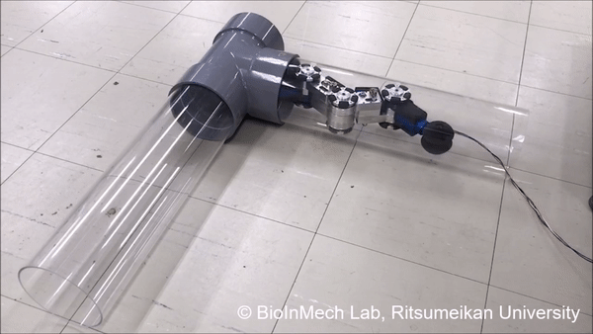
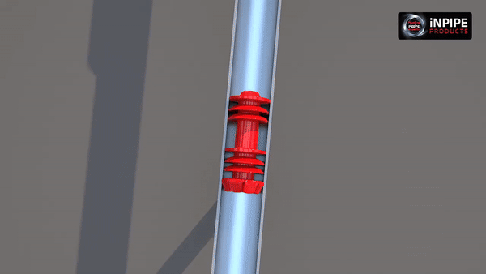
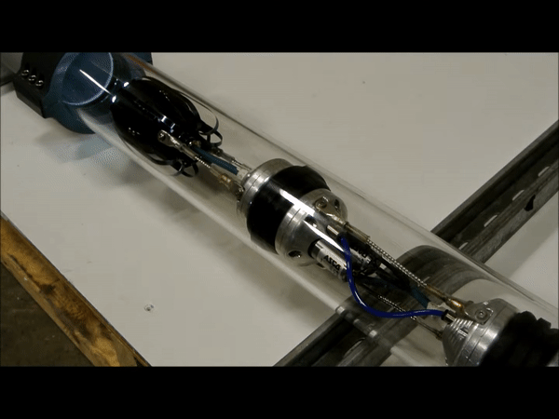
Track Mechanism
Snake Mechanism
Pigging Mechanism
Inchworm Mechanism

Slide 5
Advantages of Screw bot mechanism
Ideal for Vertical Applications as there are three or more contact points (with the pipe) which prevent it from falling off.
The structure of the bot allows it to turn smoothly through T-sections and elbow joints.
The spring in the arms allows the bot to traverse through pipes of varying diameter.
Disadvantages of Screw bot mechanism
Movement of bot is difficult through the pipes which have sudden erosion or have uneven surface.
The bot is not capable of taking turns i.e. passing through the joints while moving backwards.

Slide 6
Structure
3-D model and animation.

Slide 7
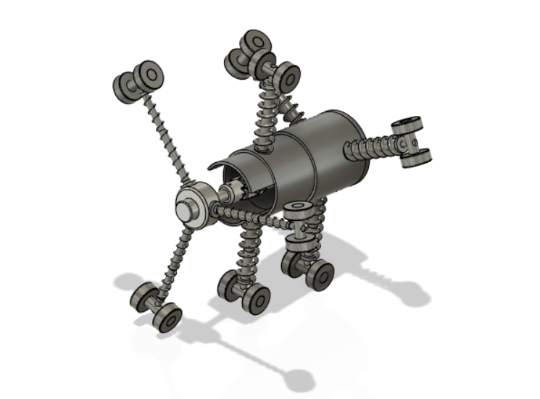
Structure

Slide 8
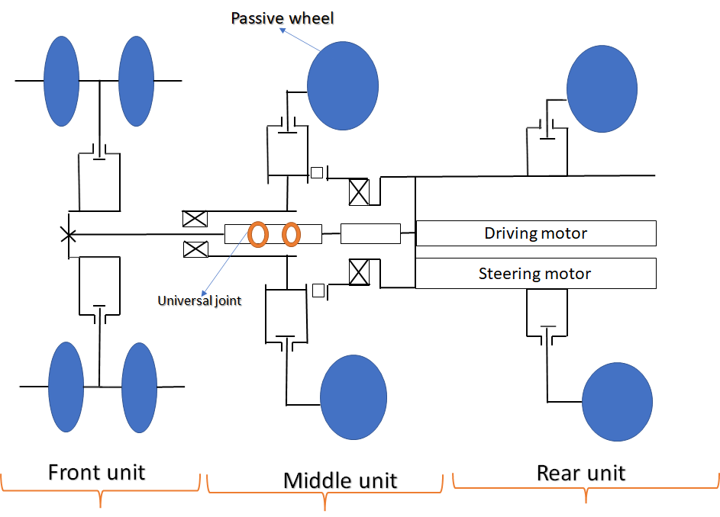
Schematic

Slide 9
Screw Driving mode
Steering Mode
Rolling Mode
Causes forward motion
Steers the bot for left-right/up-down motion
Changes orientation

Slide 10
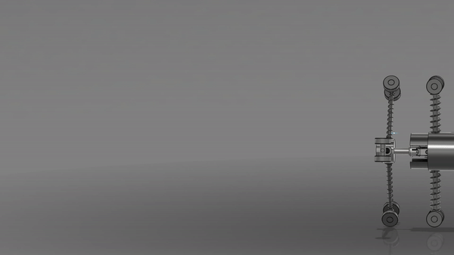
Screw driving mode
In this mode the robot moves forward or backward powered by the driving motor in the rear unit. The front unit, with its arms, rotates and generates the locomotive force for the robot to move forward using its inclined passive wheels.Simultaneously the middle and rear units act as stators because they cannot rotate due to large lateral force between wheels and inner surface of the pipes.

Slide 11
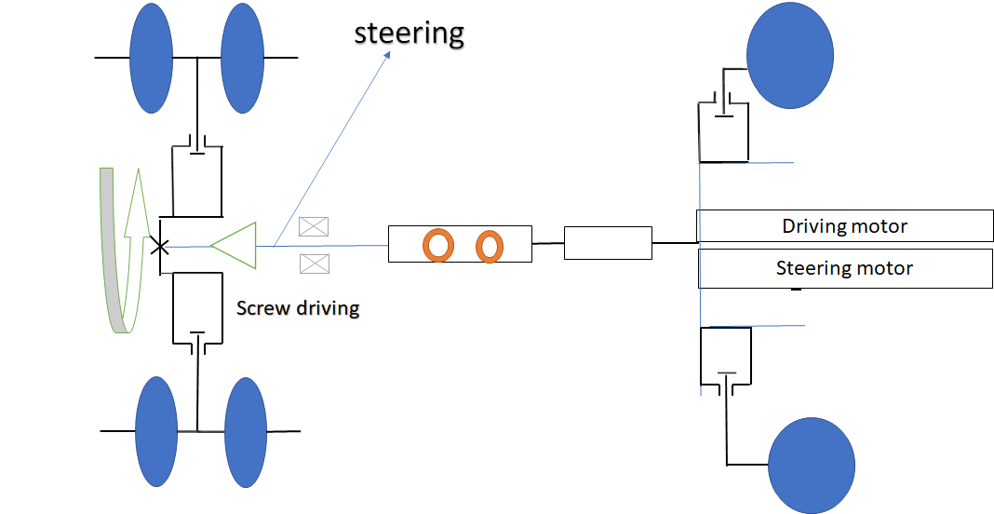

Slide 12
Steering

Slide 13
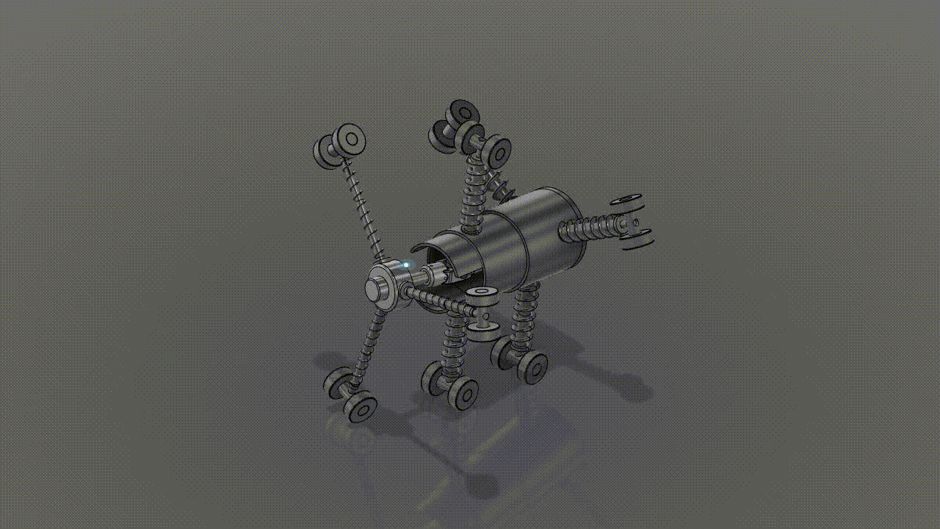
Steering mode
This mode is used in T-branches or elbow pipes.The power is transmitted from the steering motor to the spiral miter gear.When the steering motor rotates and the arms of middle unit maintain their position due to friction, the front unit steers.

Slide 15
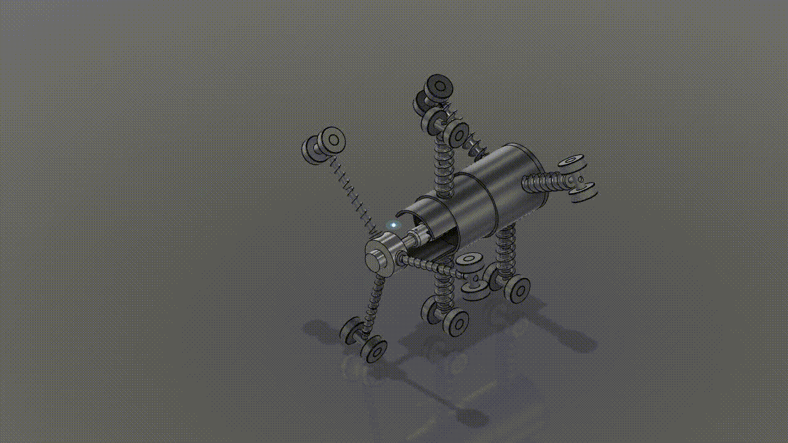

Slide 16
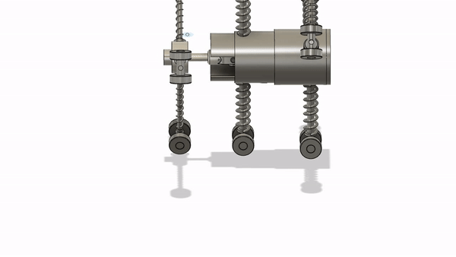
Rolling Mode
This mode uses the middle part of our bot to change the orientation of the robot allowing it to steer not only in the left right direction but also the up-down direction causing up-down motion
The middle unit rotates around the central axis, driven by the orbiting spiral miter gear.Simultaneously, the wheels of the middle unit rotate as casters in the circumferential direction.

Slide 17
Power Transfer
Gears and motion

Slide 18
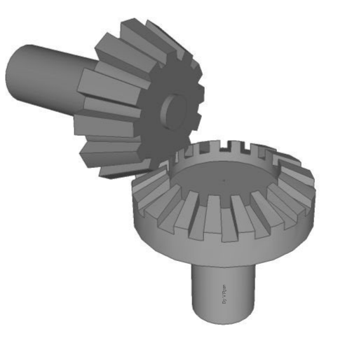
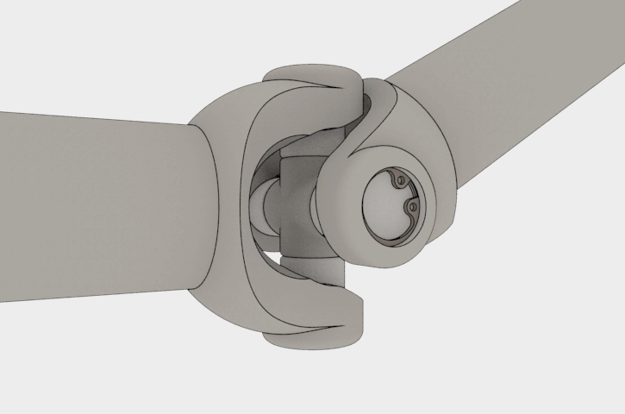
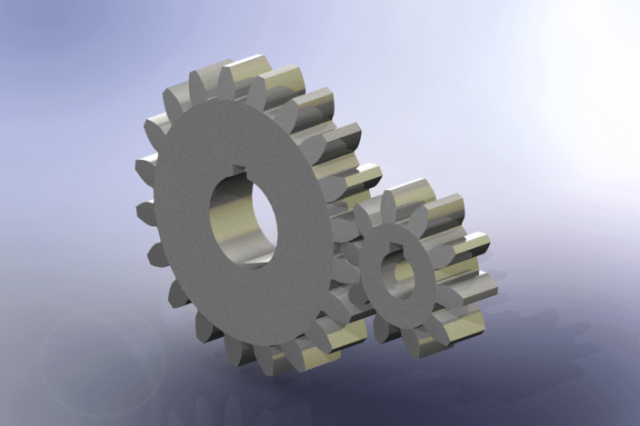
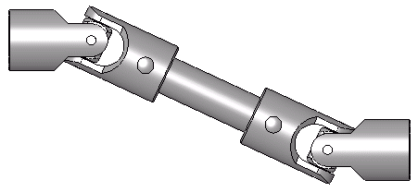
Universal Joint
Gears Being Used
Bevel Gear
Spur Gear

Slide 19
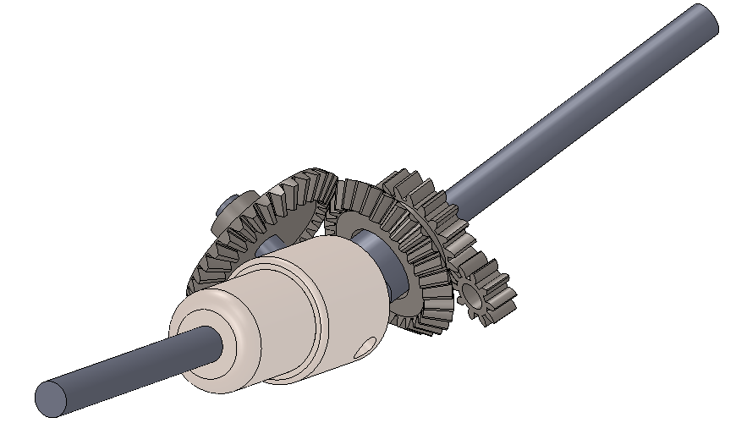
Model

Slide 20
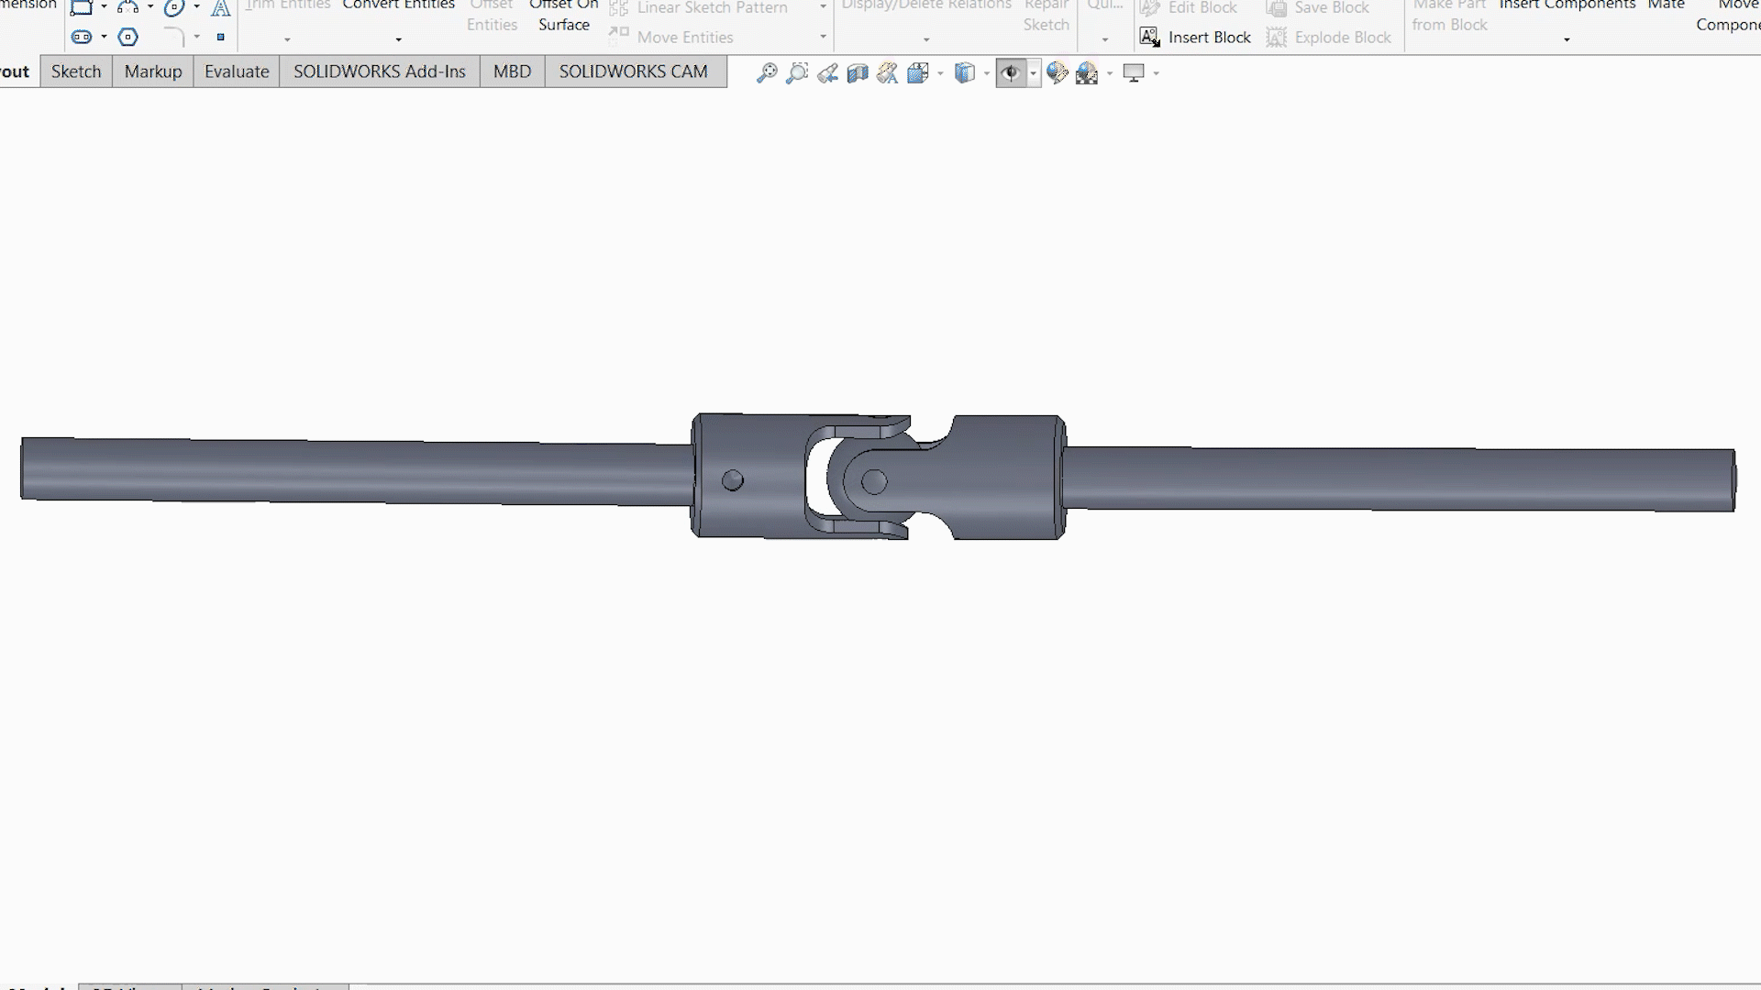
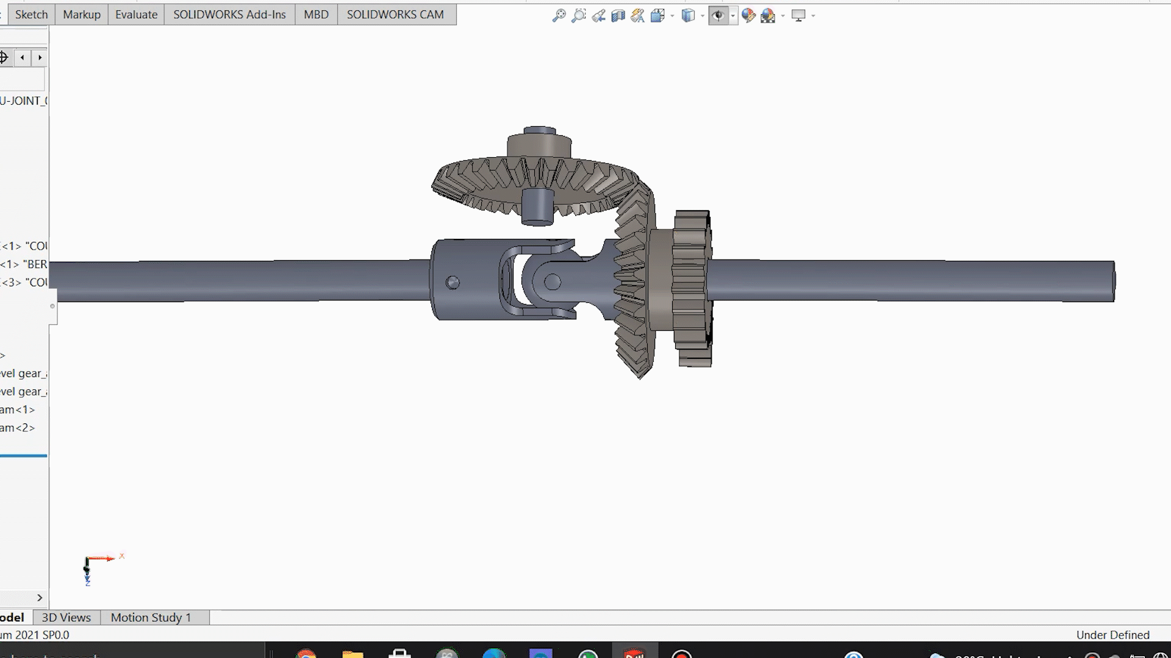
Universal Joint
Steering Mode

Slide 21
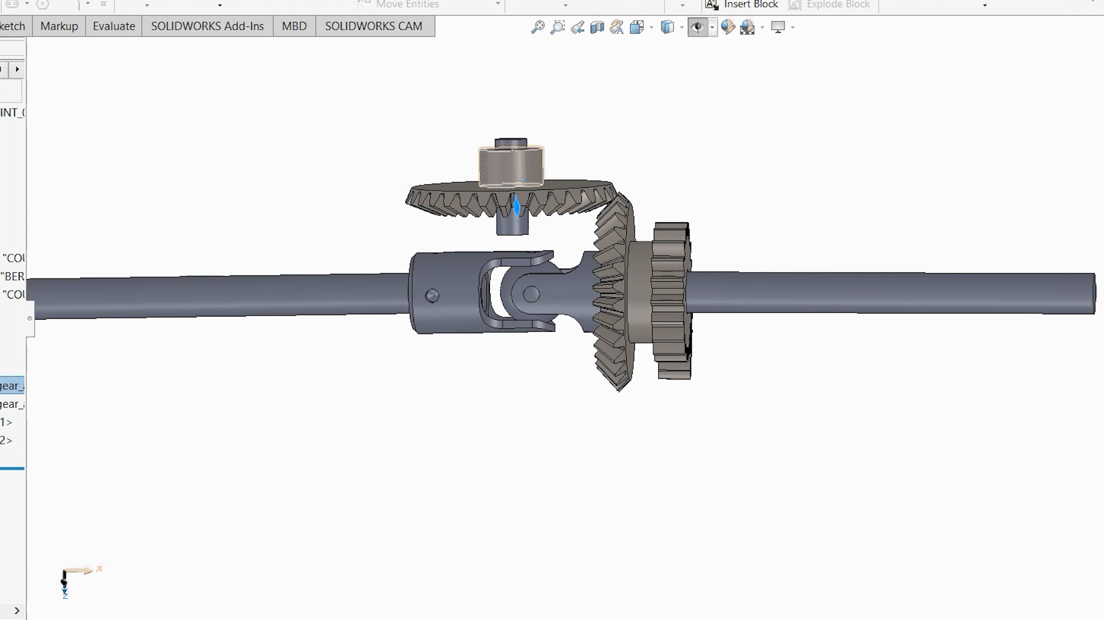
Rolling Mode

Slide 22
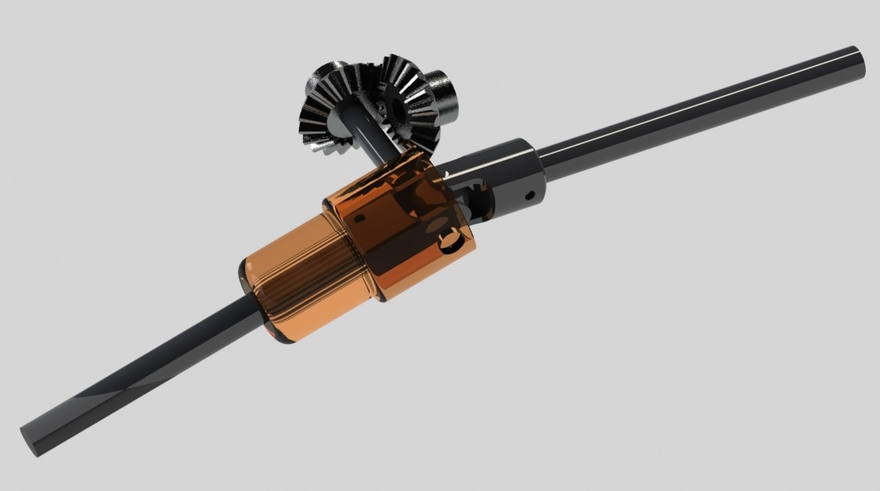
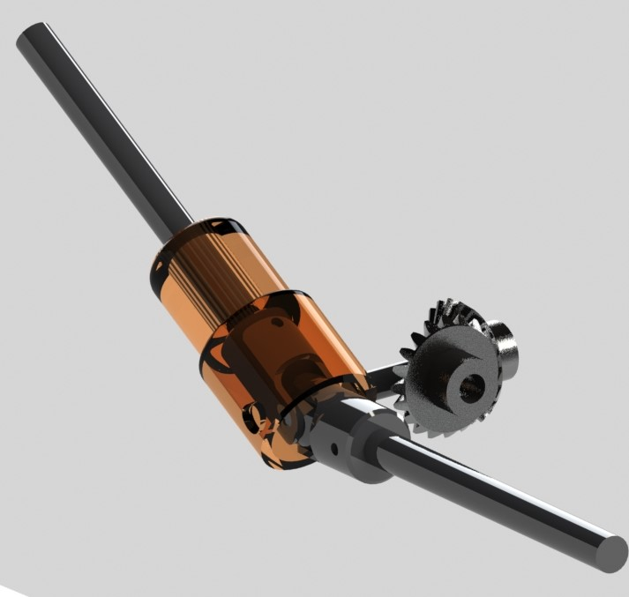
Model

Slide 23
Electronics

Slide 24
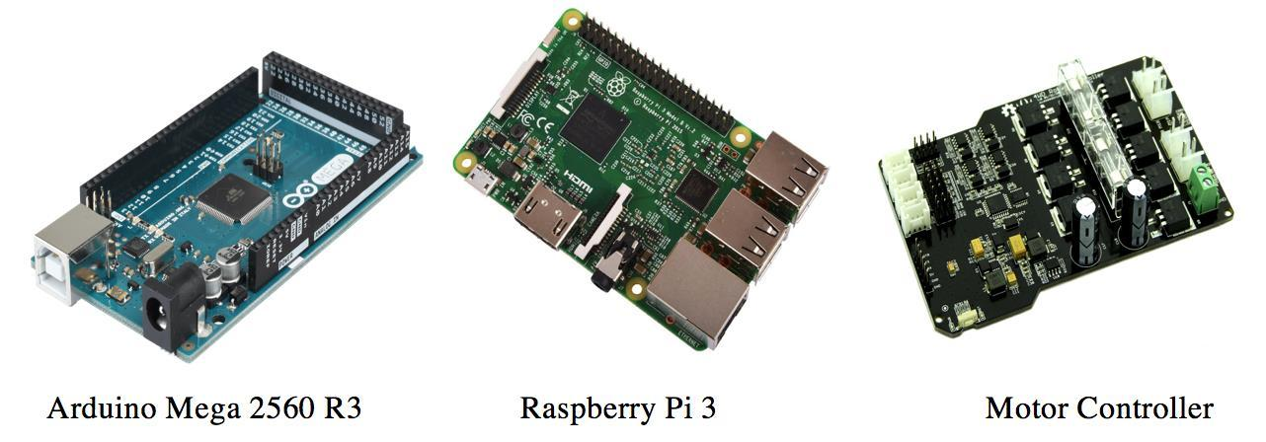
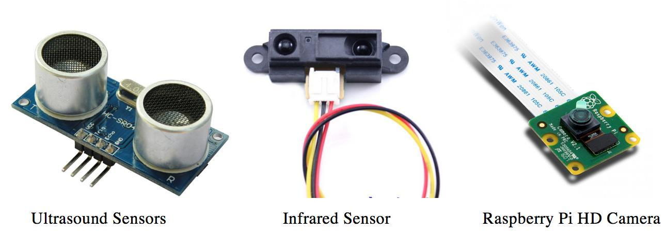
ELECTRONICS
Arduino Mega 2560 R3
Raspberry Pi 3
Raspberry Pi Camera Module
Hercules Motor Controller
USB DC-DC Converter 5V
ON-OFF Power Switch
LiPo Battery
Magnetic Encoder Pair Kit for Micro Metal Gearmotors 12 Cycles Per Revolution (CPR) Analog Distance Sensor 10cm-80cm
Ultrasonic Range Finder Sensor 15cm-250cm
Micro Metal Gearmotor High-Power(HP)
Smart White LEDs Wires
Printed circuit boards (PCBs) used in the robot
Sensors used in the robot

Slide 25
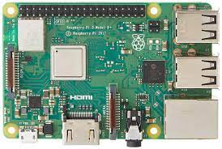
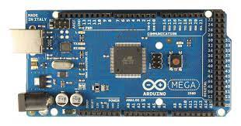
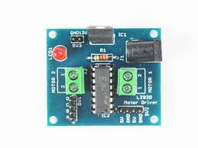
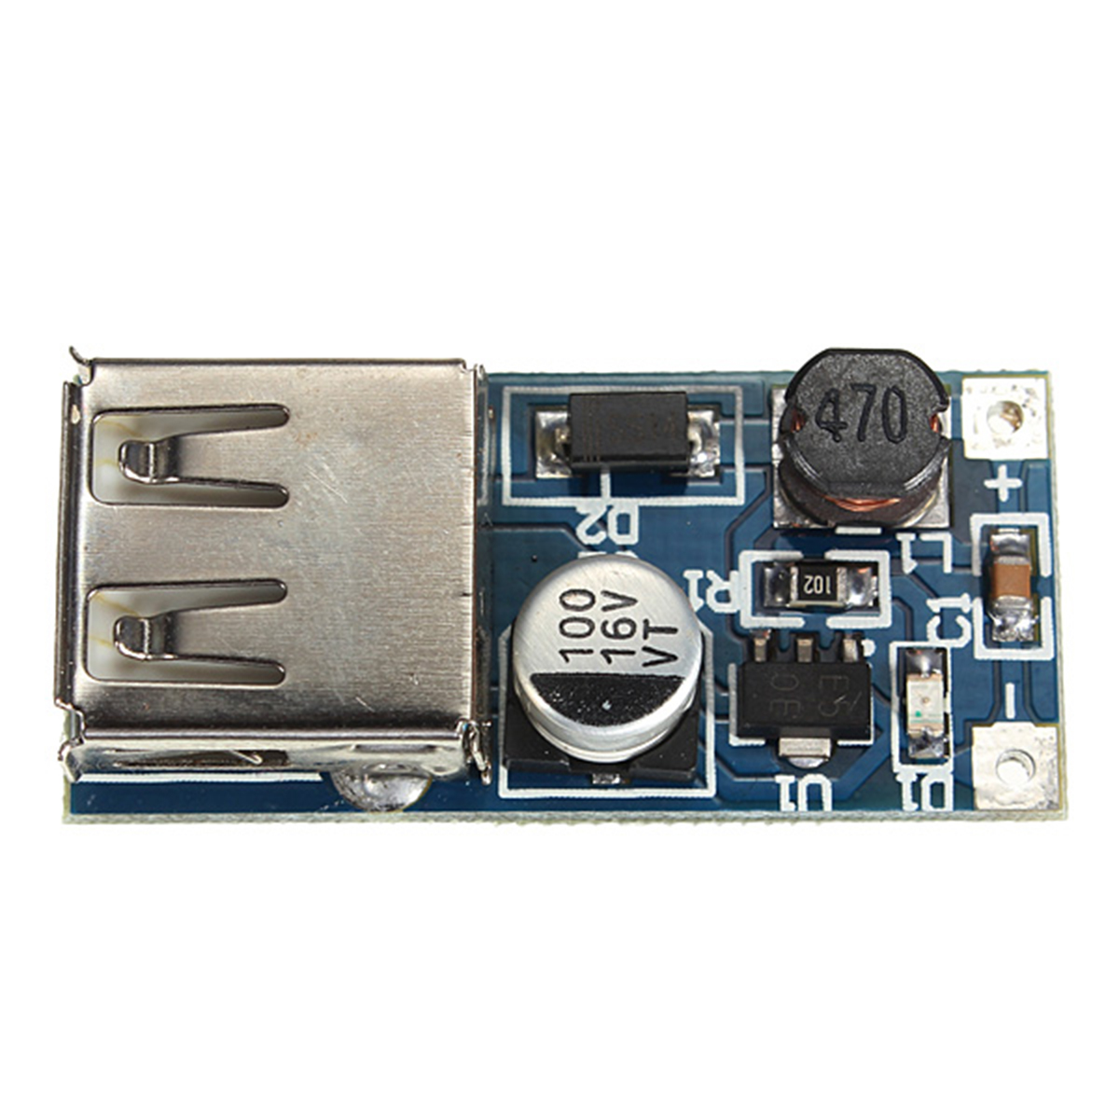
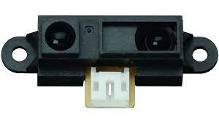
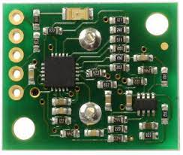
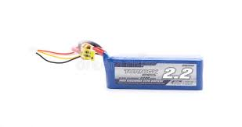
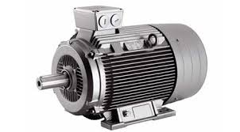
RaspBerry Pi
ELECTRONICS
Arduino Mega
USB
Motor Driver
USB DC-DC converter
Serial Bridge
IR sensor Sharp
Ultrasonic sensor
Lipo Battery
Motor (x2)

Slide 26
Purpose of the bot
Crack detection/Flaw detection

Slide 27
What Methods for Crack Detection are currently being used in the Industry
Industrial Ultrasonic Testing
Thermography
Structured Lighting
Mechanical Feeler
Image Processing Technique
Ground penetrating Radar
Microwave Imaging Technique

Slide 28
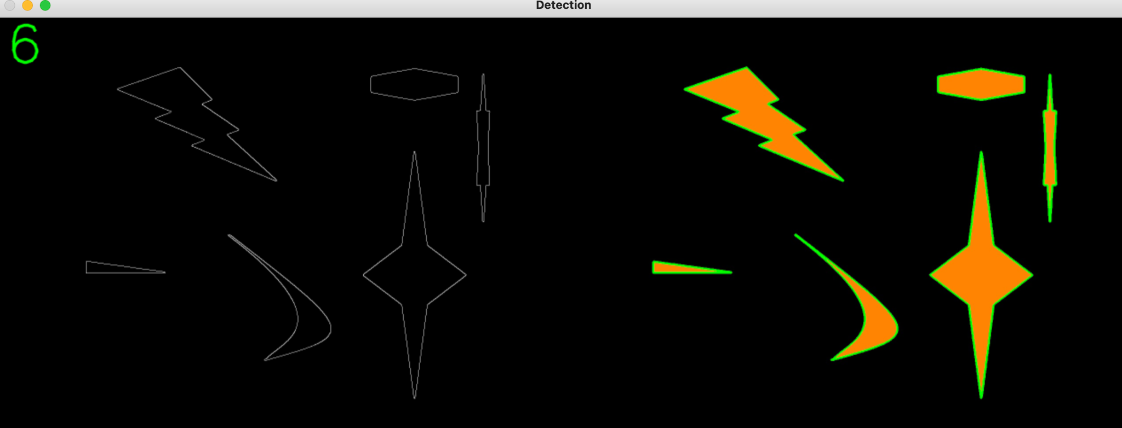
Image Processing Technique: The Image Processing Technique to detect cracks is one of the most recent techniques for crack detection be it inside industrial pipes, on pavements or on other surfaces that are susceptible of becoming cracked. It involves a number of stages including image pre-processing, edge detection, noise elimination, and others.Then, edge detection is performed using the Canny edge detection method, with an elimination of unwanted objects. After that, disjoint lines are connected and the shape of the crack, if any, is accurately described, for the defect to be finally identified based upon its length or perimeter.
Original Image
Detected Image

Slide 29
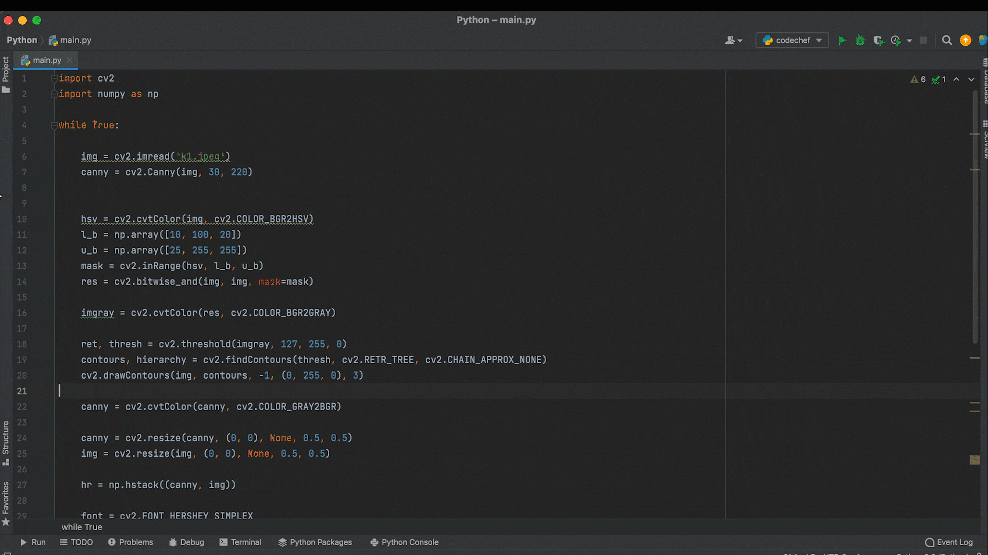
CODE

Slide 30
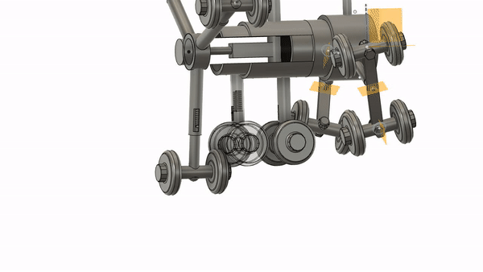
INNOVATION
The major challenge that the bot was facing was that it was not not adjustable to pipes of different diameters. Our team worked on that and designed a spring system on each set of wheel(+axle) which allowed the bot to change its radius thus giving us the option to use the bot in pipes of different diameters.
The original plans didn't allow us to house the camera system for the image detecting process. To tackle that the team came up with solutions that allowed us to do so.
The major disadvantage with the bot was the issue of non steerability while moving in backwards direction. This can be tackled by placing a similar front unit at the back end of the bot thus allowing steering motion in the backwards direction[considering that budget is not an issue :) ]

Slide 31
FUTURE WORK
The improved screw drive in-pipe robot with pathway selection mechanism proposed in this paper enables the robot to navigate through pipes using only two actuators. Three locomotion modes provide the option of selecting a pathway by steering and rolling.
ML and AI for detecting possible flaws and future cracks.
3D modelling of the pipe: pressure flow and volume change.
Extended arm for removal of any obstacle.
Rescue Operation.

Slide 32
MENTOR
Shreya Singh
TEAM MEMBERS
Arpit Sureka
Daksh Adhar
Khwmtha Basumatary
Ashutosh Kumar
Samiran Doley
Vishvesh S Warrier
Archit Avadhane

